Slide 1


CORONA VIRUS ANALYSIS USING SQL
DATA ANALYSIS PROJECT
Internship: MENTORNESS
Task 2
Batch Name: MIP-DA-07

Slide 2
PROBLEM STATEMENT
The CORONA VIRUS pandemic has had a significant impact on public health and has created an urgent
need for data-driven insights to understand the spread of the virus. As a data analyst, you have been
tasked with analyzing a CORONA VIRUS dataset to derive meaningful insights and present your findings.

Slide 3
OBJECTIVE
This project aims to leverage SQL for comprehensive analysis of COVID-19 data, encompassing case details, testing outcomes, hospitalization records, demographics, and vaccination data.
Tasks include querying total cases globally and regionally, analyzing testing trends, assessing hospitalization severity and demographic correlations, and evaluating vaccination progress.
The output will consist of actionable insights presented through SQL queries and visualizations, facilitating informed decision-making for effective public health interventions.

Slide 4
DATASET
Province: Geographic subdivision within a country/region.
Country/Region: Geographic entity where data is recorded.
Latitude: North-south position on Earth's surface.
Longitude: East-west position on Earth's surface.
Date: Recorded date of CORONA VIRUS data.
Confirmed: Number of diagnosed CORONA VIRUS cases.
Deaths: Number of CORONA VIRUS related deaths.
Recovered: Number of recovered CORONA VIRUS cases.

Slide 5

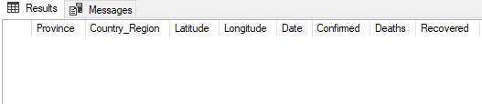
Q1. Write a code to check NULL values
SELECT *
FROM [dbo].[task2_1]
WHERE Province IS NULL AND
Country_Region IS NULL AND
Latitude IS NULL AND
Longitude IS NULL AND
Date IS NULL AND
Confirmed IS NULL AND
Deaths IS NULL AND
Recovered IS NULL;

Slide 6
Q2. If NULL values are present, update them with zeros for all columns.
UPDATE [dbo].[task2_1]
SET Province = '0'
WHERE Province IS NULL;
UPDATE [dbo].[task2_1]
SET [Country_Region] = '0'
WHERE [Country_Region] IS NULL;
UPDATE [dbo].[task2_1]
SET Latitude = '0'
WHERE Latitude IS NULL;
UPDATE [dbo].[task2_1]
SET Longitude = '0'
WHERE Longitude IS NULL;
UPDATE [dbo].[task2_1]
SET Date = NULL
WHERE Date IS NULL;
UPDATE [dbo].[task2_1]
SET Confirmed = '0'
WHERE Confirmed IS NULL;
UPDATE [dbo].[task2_1]
SET Deaths = '0'
WHERE Deaths IS NULL;
UPDATE [dbo].[task2_1]
SET Recovered = '0'
WHERE Recovered IS NULL;

Slide 7

Q3. Check total number of rows
SELECT COUNT(*) AS Count_Of_Rows
FROM [dbo].[task2_1];

Slide 8
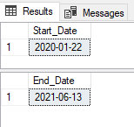
Q4. Check what is start_date and end_date
SELECT MIN(Date) AS Start_Date
FROM [dbo].[task2_1];
SELECT MAX(Date) AS End_Date
FROM [dbo].[task2_1];

Slide 9

Q5. Number of month present in dataset
SELECT COUNT(DISTINCT YEAR(Date) * 12 + MONTH(Date)) AS number_of_months
FROM [dbo].[task2_1];

Slide 10
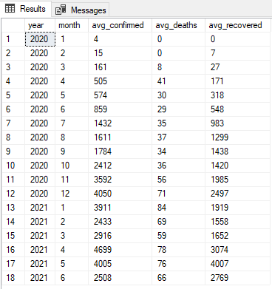
Q6. Find monthly average for confirmed, deaths, recovered
SELECT
YEAR(Date) AS year,
MONTH(Date) AS month,
AVG(confirmed) AS avg_confirmed,
AVG(deaths) AS avg_deaths,
AVG(recovered) AS avg_recovered
FROM
[dbo].[task2_1]
GROUP BY
YEAR(Date),
MONTH(Date)
ORDER BY
YEAR(Date),
MONTH(Date);

Slide 11
Q7. Find most frequent value for confirmed, deaths, recovered each month
WITH MonthlyStats AS (
SELECT
YEAR(Date) AS year,
MONTH(Date) AS month,
Confirmed,
Deaths,
Recovered,
ROW_NUMBER() OVER (PARTITION BY YEAR(Date), MONTH(Date) ORDER BY COUNT(*) DESC) AS rn_confirmed,
ROW_NUMBER() OVER (PARTITION BY YEAR(Date), MONTH(Date) ORDER BY COUNT(*) DESC) AS rn_deaths,
ROW_NUMBER() OVER (PARTITION BY YEAR(Date), MONTH(Date) ORDER BY COUNT(*) DESC) AS rn_recovered

Slide 12
FROM
[dbo].[task2_1]
WHERE
Confirmed <> 0 AND Deaths <> 0 AND Recovered <> 0
GROUP BY YEAR(Date), MONTH(Date), Confirmed, Deaths, Recovered
)
SELECT year, month, Confirmed, Deaths, Recovered
FROM
MonthlyStats
WHERE
rn_confirmed = 1 OR rn_deaths = 1 OR rn_recovered = 1;

Slide 13
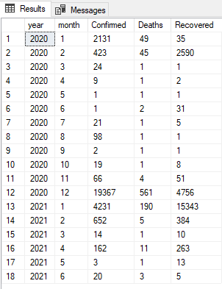

Slide 14

Q8. Find minimum values for confirmed, deaths, recovered per year
SELECT
YEAR(Date) AS year,
MIN(confirmed) AS min_confirmed,
MIN(deaths) AS min_deaths,
MIN(recovered) AS min_recovered
FROM
[dbo].[task2_1]
GROUP BY
YEAR(Date);

Slide 15

Q9. Find maximum values of confirmed, deaths, recovered per year
SELECT
YEAR(Date) AS year,
MAX(confirmed) AS max_confirmed,
MAX(deaths) AS max_deaths,
MAX(recovered) AS max_recovered
FROM
[dbo].[task2_1]
GROUP BY
YEAR(Date);

Slide 16
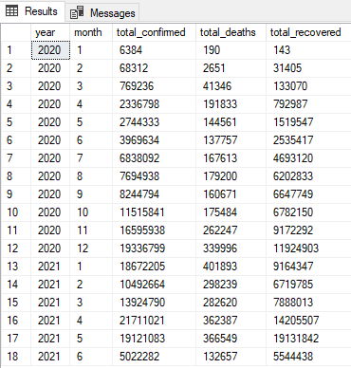
Q10. The total number of case of confirmed, deaths, recovered each month
SELECT
YEAR(Date) AS year,
MONTH(Date) AS month,
SUM(confirmed) AS total_confirmed,
SUM(deaths) AS total_deaths,
SUM(recovered) AS total_recovered
FROM
[dbo].[task2_1]
GROUP BY YEAR(Date), MONTH(Date)
ORDER BY YEAR(Date), MONTH(Date);

Slide 17
Q11. Check how corona virus spread out with respect to confirmed case (E.g.: total confirmed cases, their average, variance & STDEV )
SELECT SUM(confirmed) AS total_confirmed_cases FROM [dbo].[task2_1];
SELECT AVG(confirmed) AS average_confirmed_cases FROM [dbo].[task2_1];
SELECT VARP(Confirmed) AS variance_confirmed_cases FROM [dbo].[task2_1];
SELECT STDEV(confirmed) AS stdev_confirmed_cases FROM [dbo].[task2_1];

Slide 18
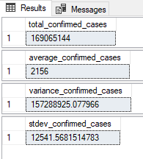
Q11. Check how corona virus spread out with respect to confirmed case (E.g.: total confirmed cases, their average, variance & STDEV )

Slide 19
Q12. Check how corona virus spread out with respect to death case per month (E.g.: total confirmed cases, their average, variance & STDEV )
-- Total Deaths as per month
SELECT
YEAR(Date) AS year,
MONTH(Date) AS month,
SUM(deaths) AS total_death_cases
FROM
[dbo].[task2_1]
GROUP BY
YEAR(Date),
MONTH(Date)
ORDER BY
YEAR(Date),
MONTH(Date);
-- Average deaths as per month
SELECT
YEAR(Date) AS year,
MONTH(Date) AS month,
AVG(deaths) AS average_death_cases
FROM
[dbo].[task2_1]
GROUP BY
YEAR(Date),
MONTH(Date)
ORDER BY
YEAR(Date),
MONTH(Date);

Slide 20
-- Variance Deaths as per month
SELECT
YEAR(Date) AS year,
MONTH(Date) AS month,
ROUND(VARP(deaths),2) AS variance_death_cases
FROM
[dbo].[task2_1]
GROUP BY
YEAR(Date),
MONTH(Date)
ORDER BY
YEAR(Date),
MONTH(Date);
-- Standard deviation Death as per month
SELECT
YEAR(Date) AS year,
MONTH(Date) AS month,
ROUND(STDEV(deaths),2) AS
sd_death_cases
FROM
[dbo].[task2_1]
GROUP BY
YEAR(Date),
MONTH(Date)
ORDER BY
YEAR(Date),
MONTH(Date);

Slide 21
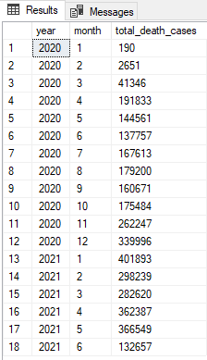
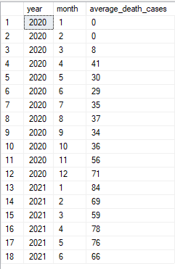
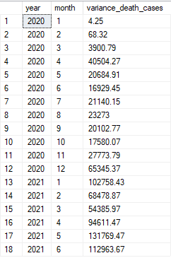
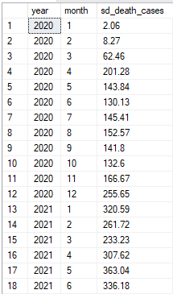

Slide 22
Q13. Check how corona virus spread out with respect to recovered case (E.g.: total confirmed cases, their average, variance & STDEV )
SELECT SUM(Recovered) AS total_recovered_cases FROM [dbo].[task2_1];
SELECT AVG(Recovered) AS average_recovered_cases FROM [dbo].[task2_1];
SELECT ROUND(VARP(Recovered),2) AS variance_recovered_cases FROM [dbo].[task2_1];
SELECT ROUND(STDEV(Recovered),2) AS stdev_recovered_cases FROM [dbo].[task2_1];

Slide 23
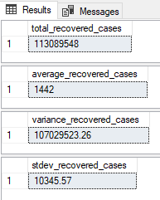
Q13. Check how corona virus spread out with respect to recovered case (E.g.: total confirmed cases, their average, variance & STDEV )

Slide 24

Q14. Find Country having highest number of the Confirmed case
SELECT TOP 1 Country_Region, MAX(Confirmed) AS Highest_Confirmed_Cases
FROM [dbo].[task2_1]
GROUP BY Confirmed, Country_Region
ORDER BY Confirmed DESC;

Slide 25

Q15. Find Country having lowest number of the death case
SELECT TOP 1 Country_Region, Deaths AS Least_Death_Cases
FROM [dbo].[task2_1]
WHERE Deaths > 0
ORDER BY Deaths ASC;

Slide 26
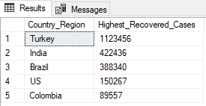
Q16. Find top 5 countries having highest recovered case
SELECT TOP 5 Country_Region, MAX(Recovered) AS Highest_Recovered_Cases
FROM [dbo].[task2_1]
GROUP BY Country_Region
ORDER BY MAX(Recovered) DESC;

Slide 27
INSIGHTS
Monthly averages for confirmed cases, deaths, and recoveries show fluctuations over time.
The most frequent values for confirmed cases, deaths, and recoveries vary from month to month, indicating dynamic patterns in the spread and recovery rates of COVID-19.
Turkey has recorded the highest number of confirmed cases, indicating the severity of the outbreak in that region.
Conversely, Ghana has reported the lowest number of deaths, suggesting effective management of COVID-19 mortality.
The top five countries with the highest number of recoveries include Turkey, India, Brazil, US, Colombia reflecting successful recovery efforts in those regions.

Slide 28
RECOMMENDATIONS
Target interventions in regions with high case counts to mitigate the spread of COVID-19 and prevent further outbreaks.
Monitor temporal trends closely for timely interventions and adjustments to public health measures.
Prioritize resources for countries with high recovery rates to support ongoing recovery efforts and reduce the burden on healthcare systems.

Slide 29
THANK YOU

